Slide 1


Slide 2
CONSTRUCTION COMPANY WEB-DEVELOPEMENT
Presented By
Students Name | Roll No. | Enrollment no.
PRATHAM BABURAO PAWAR | 3131 | 2005390155
ALANKAR SHIVAJI KAMBLE | 3109 | 2105390289
AVADHUT DNYANDEO PATIL | 3112 | 2000100483
TUSHAR DHONDIRAM SHINDE | 3111 | 2105390303
YOGESH ATUL DEOKAR | 3110 | 2105390300
Guided By
Mrs. C. B. KAMBLE
Department of Computer Engineering
Dr. D.Y.Patil Polytechnic, Kasaba Bawada,
Kolhapur

Slide 3
Agenda:
Introduction
Aim
Purpose of project
Features
Resources and consumables required
Advantages of websites
DFD Diagram
Actual Project
Scope of Project

Slide 4
Introduction:
After the lockdowns and general economic slowdown due to the pandemic, the construction industry is not only recovering but is actually about to become an engine of global economic growth in the decade to 2030. Innovations in the industry, including cloud technology and mobile applications, should provide the instruments for enhanced efficiency, job site safety, quality, and productivity.
According to the 2020 JBKnowledge ConTech Report:
92% of construction industry workers used a smartphone for work
65% of respondents also used a tablet for work purposes
22% of companies were using six or more applications for their daily operations
If you are running a construction company, don’t miss out on the big opportunity of generating consistent leads. A well- qualified website will create profits, generate leads, traffic, and customer outreach.

Slide 5
Aim of Project:
The constraints of best quality.
The main goal of construction industry is to ensure that construction projects are successfully completed.
Stated period and with minimum cost possible.
Easy mobile navigation.

Slide 6
Purpose of Project:
To provide variety of architectural designes to client.
Exchange information between client and contractor of our sites without any meetings.
24×7 company open through website.
Client able to see the past history of company and then decide
Wide range information provided throughout website

Slide 7
Features:
Better communication in the customer and owner
User-friendly user interface
Time efficient
Security features. This is something that's most important to websites where visitors may enter credit card or other sensitive information.
Easy to deal with customer

Slide 8
Resources and consumables Required:
Computer Hardware (OS Windows 7 or Onwards, Intel i3/i5, minimum 4GB Ram).
Google-cloud
html5
node.JS
React.JS
PHP
MongoDB
JavaScript
Various frameworks of React
Anti virus.

Slide 9
Advantages of websites:
Market expansion
Advertise of company
Online presence of company through website
A good designed website can be provide real sites images and create a trust among client and contractor.
Contractor can upload current prices of materials which they can use with current price

Slide 10
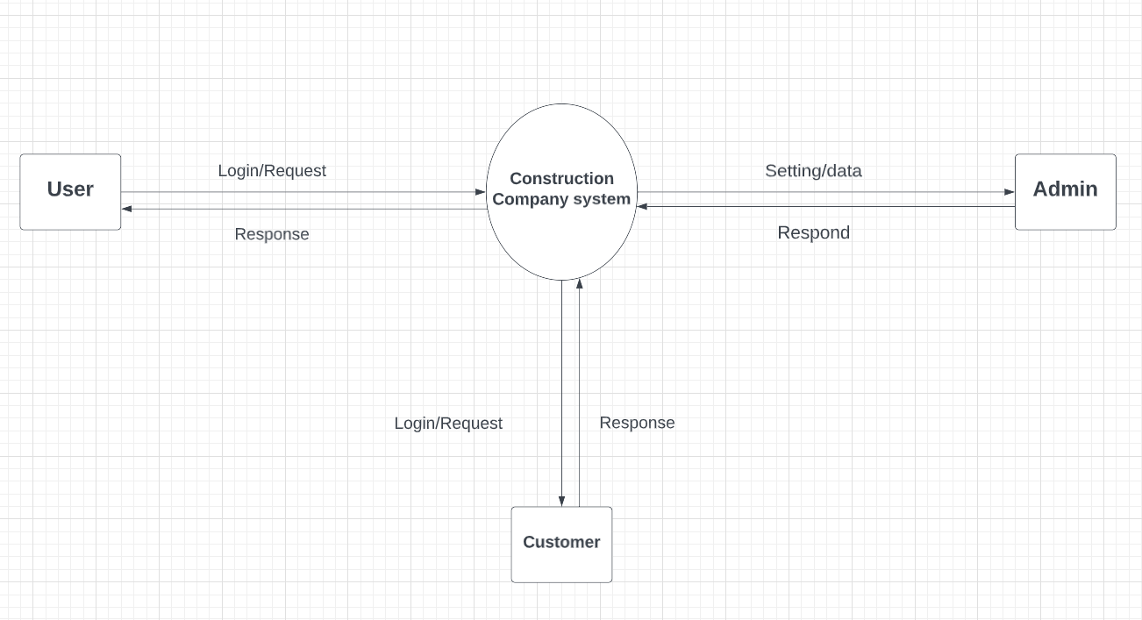
DFD Diagram:-
Fig no.1

Slide 11
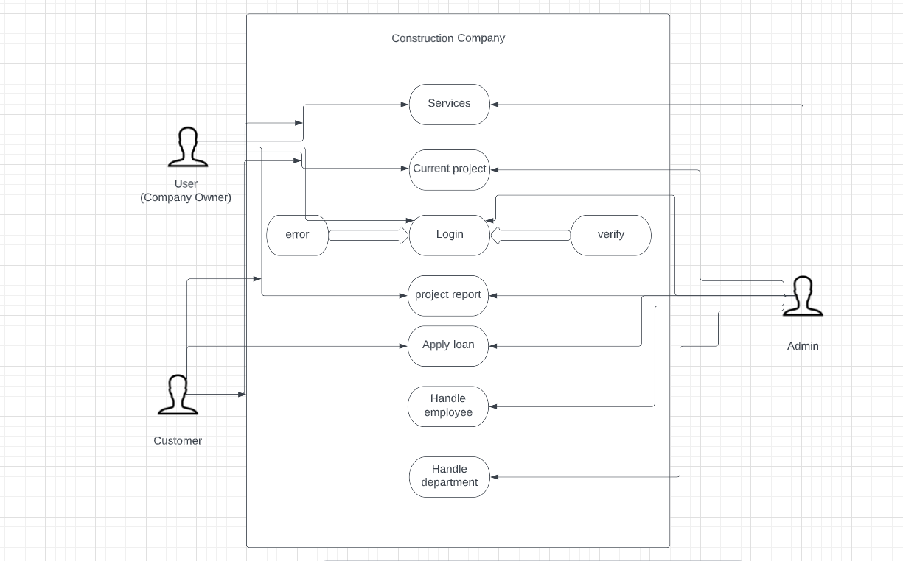
Fig no.2

Slide 12
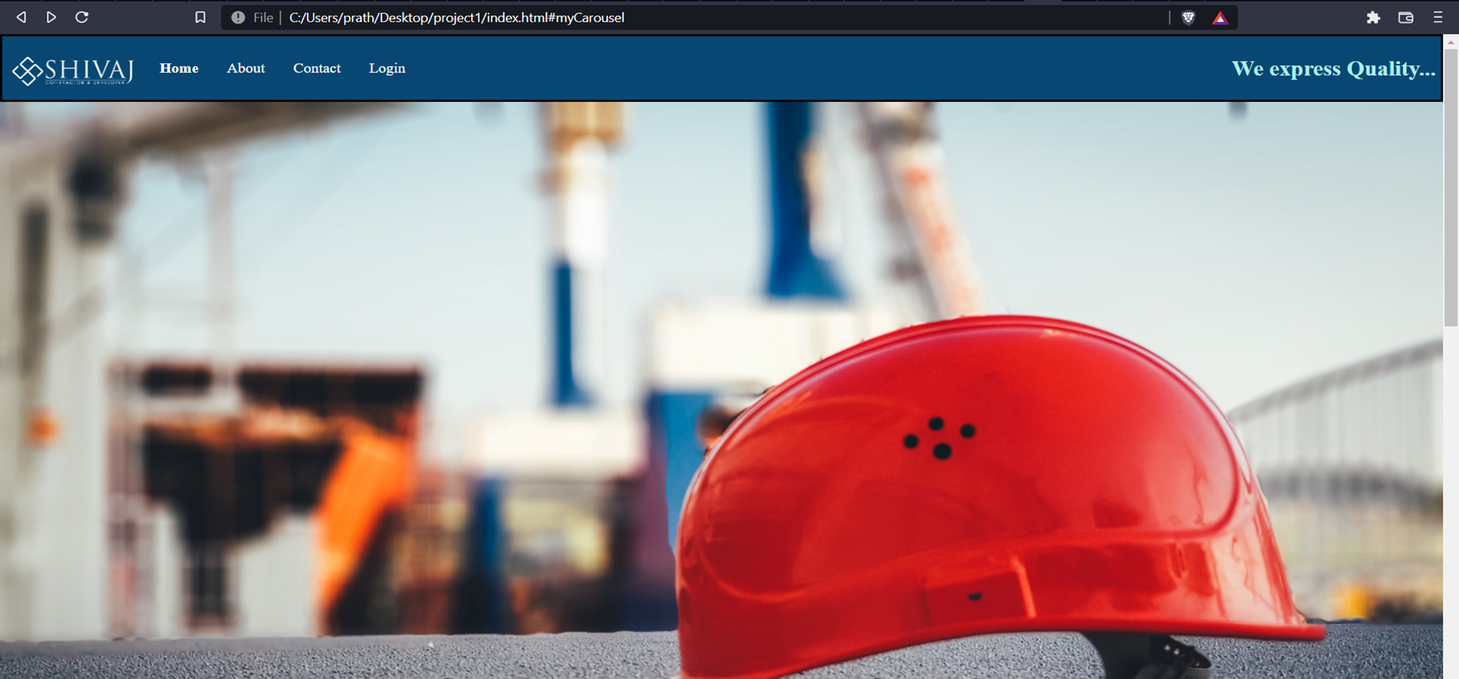
Actual projects:
Main Page:-

Slide 13
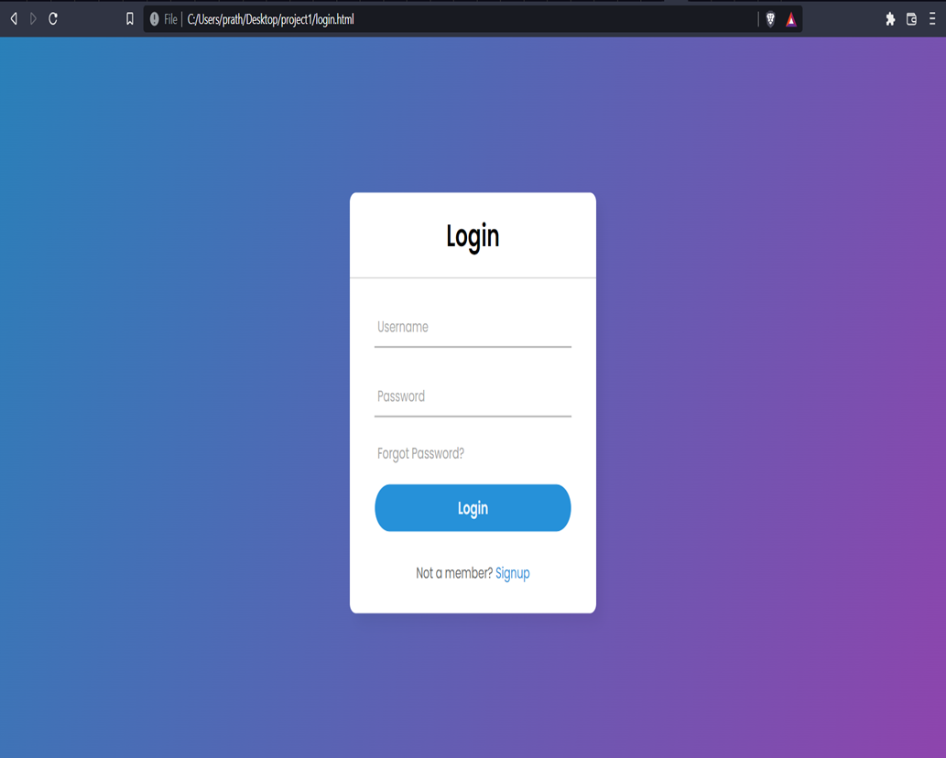
Login Page :-

Slide 14
Scope of Project:
The construction business is one of the most successful businesses in today’s world. Advertising strategies have taken a new pattern into online marketing from mouth to mouth publicity and physical advertising.
Our project provide the websites on a rental basis to the customers or clients those are unable to
create their own website.
We create the most appealing, secured and easy to work with-type and cost efficient websites.
Our goal is to make everyone able to start their own online businesses regardless of the knowledge of programming languages.

Slide 15
Thank You

